Slide 1
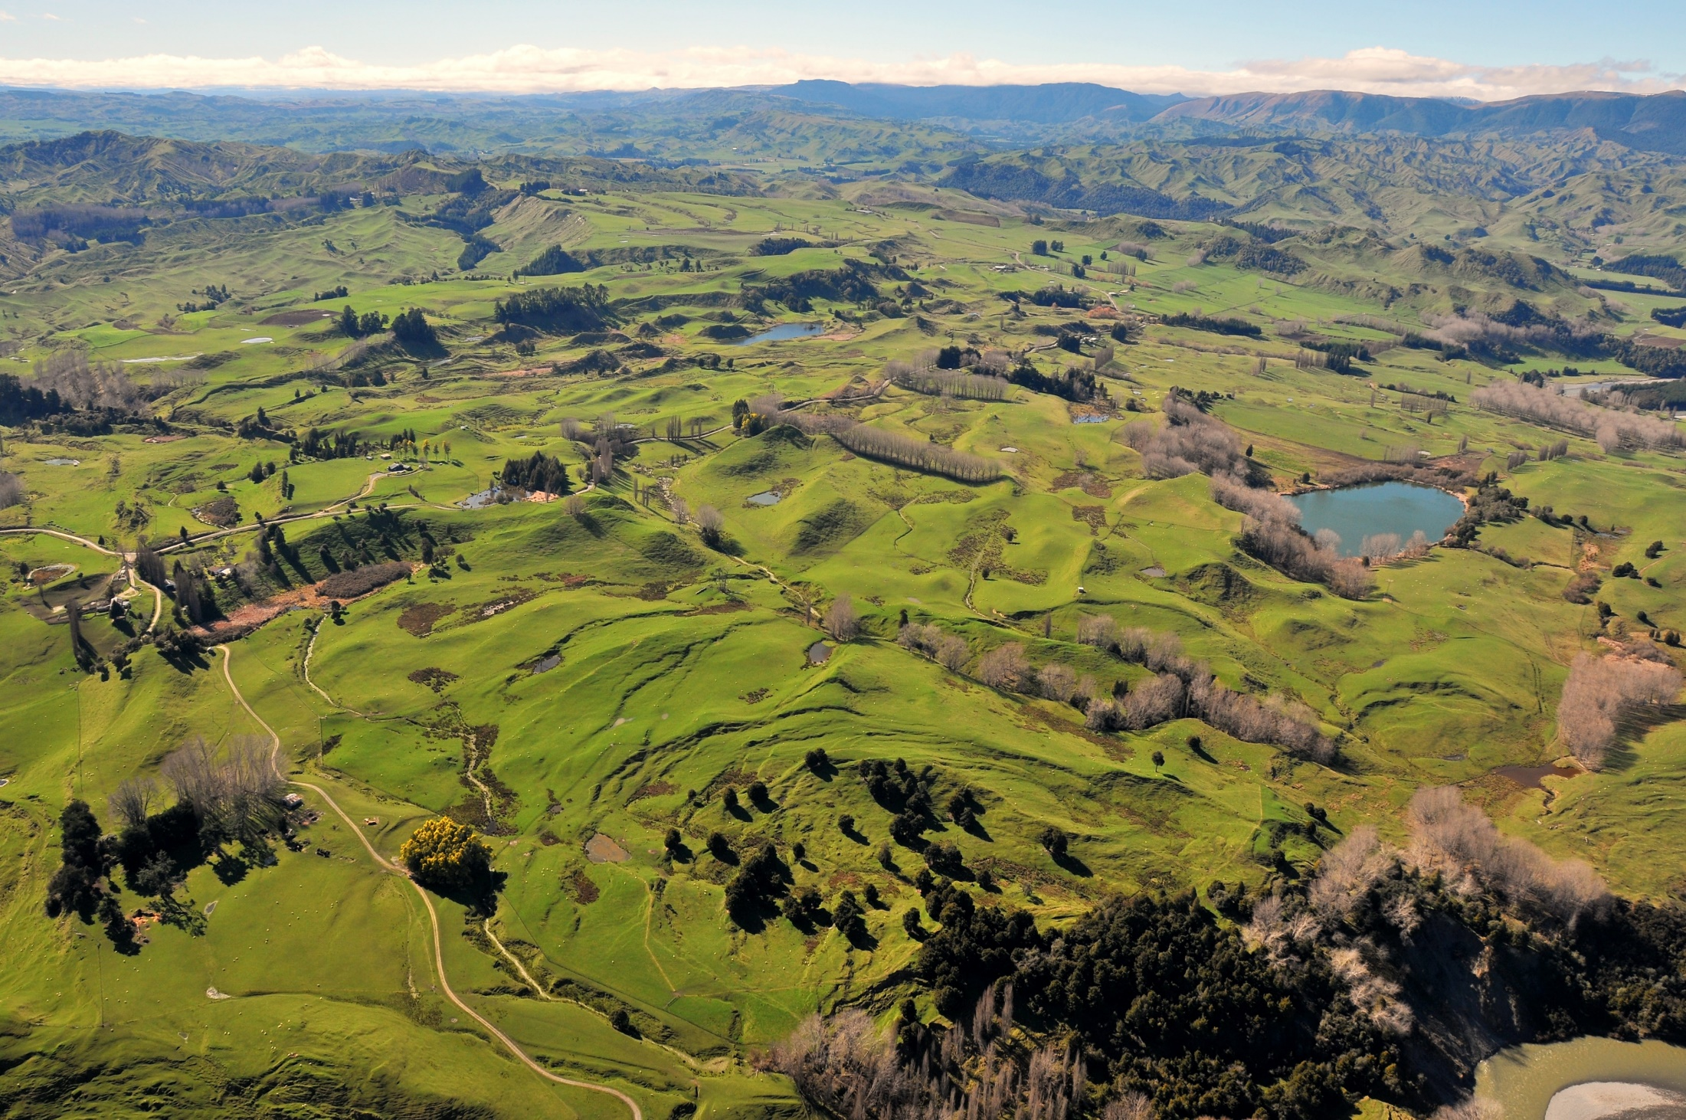

Operationalizing InSAR and Pixel Offset Time Series Methodologies for Landslide Monitoring
AGU Fall Meeting Dec 16th, 2021
f.williams1@massey.ac.nz
Notes:
Hello, thank you for taking the time to view my presentation. My name is Forrest Williams and I am a PhD student at Massey University in New Zealand. I’m excited to share some of my recent work with you!
Similar to some areas along the US west coast, large slow-moving landslides are present throughout New Zealand and have been the cause of major infrastructure damage in many places. In this presentation I will show you how we have been using InSAR and pixel offset tracking to monitor landslides in New Zealand.

Slide 2
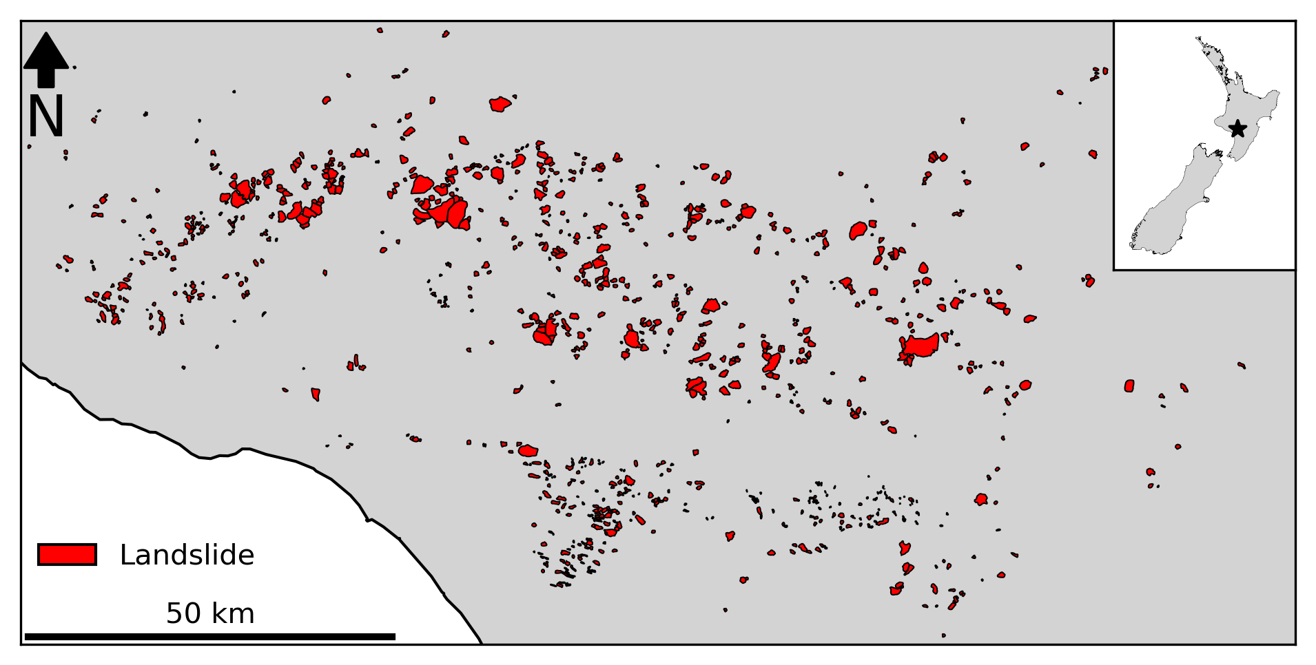
Motivation | Workflow | Results | Next Steps
f.williams1@massey.ac.nz
Notes:
Due to the fast uplift rates and low internal strength of the bedrock in many parts of New Zealand, large slow-moving landslides can be found throughout New Zealand, but we are particularly concerned with a roughly 200 x 100 km area in the southern portion of the North Island that is particularly prone to landsliding.
This area is part of a large sedimentary basin that was uplifted before the processes of diagenesis could adequately increase the internal strength of basin sediments, which has led to a sequence of weak mudstones and sandstones that gently dip to the southwest that very prone to landsliding.
For our publication in the September issue of Geomorphology, we remapped 935 large landslides in this area based on the presence of geomorphic attributes that are indicative of landslide presence. Those landslides are shown here. However, this database of landslides contains many landslides that are likely relict landslides that are inactive today.

Slide 3
From this…
To this!
There are 935 mapped landslides in this area
?
There are 935 mapped landslides in this area, 50 are active, and 5 are moving faster than 1 m/yr
Motivation | Workflow | Results | Next Steps
f.williams1@massey.ac.nz
Notes:
While it’s useful to map both relict and active landslides, it would be even more useful to have information on which of these landslides are active, and which are inactive.
Recently we have developed a workflow based on a SBAS InSAR analysis and pixel offset tracking that allow us to update our landslide database with information on each landslide’s activity state and it’s movement rate.
In this presentation, I will describe this workflow, show you some initial results and share with you some of the challenges we’ve encountered.

Slide 4
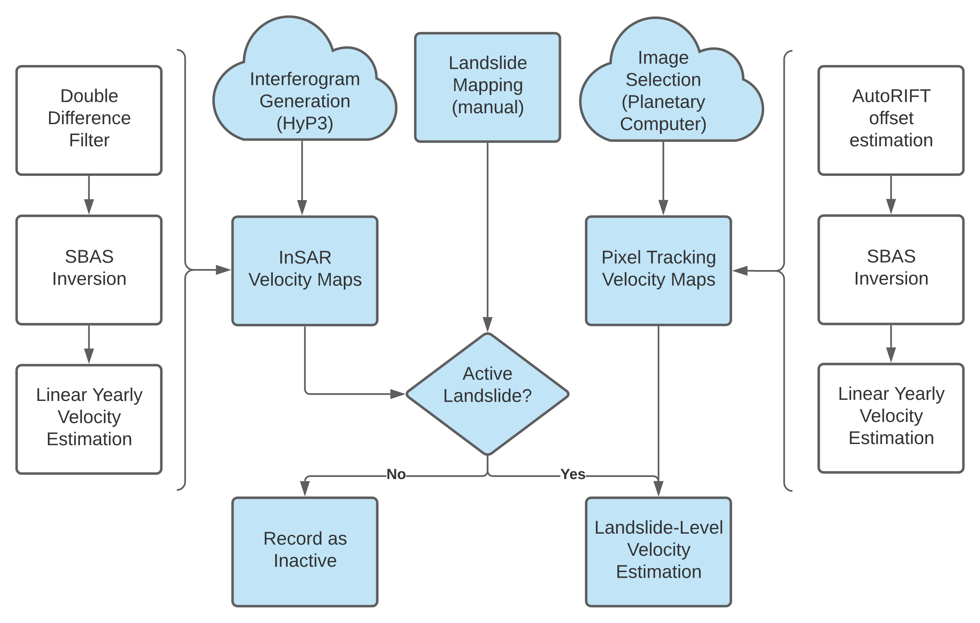
Motivation | Workflow | Results | Next Steps
f.williams1@massey.ac.nz
Notes:
This flowchart gives a schematic overview of our workflow. I will cover each step briefly, but I am also happy to share that the entirety of this workflow uses open-source tools and is fully contained with Python Jupyter Notebooks that are freely available on GitHub at the links provided at the end of this presentation.
We hope that these notebooks will assist others who would like to perform a similar analysis and we welcome any suggestions you have for improving our analysis on these GitHub pages.
Broadly, our workflow can be divided into two separate analyses. The first is a SBAS InSAR workflow that utilizes Sentinel 1 data, and the other is a pixel-offset analysis that utilizes Sentinel 2 data. As anyone who has performed these types of analyses knows, these analyses can be very resource intensive both in terms of compute power and data storage, because of this we have utilized cloud-computing frameworks to do much of the initial data processing.
For the InSAR analysis, we have utilized the Alaska Satellite Facility’s fantastic HyP3 program, which uses Amazon Web Services and Sentinel-1 data, to generate on-demand interferograms which we use in our analysis. We requested interferograms with the nearest three acquisitions in time for each SLC that intersected our study area (including both the ascending and descending orbits).
These interferograms were loaded into mintpy, a python-based SBAS InSAR timeseries tool, where the SBAS analysis was conducted. Prior to the timeseries inversion, a double difference filter was applied to all interferograms. This filter is described in Dr. Bekaert’s 2020 paper in Remote Sensing of Environment and is the difference between local average and regional average filter.
For the local average filter, a diameter of 200 m was used, and for the regional filter, a 2 km diameter was used. This filter is ideal for identifying local sources of deformation like landslides because it removes spatially-correlated tropospheric phase delays at the local level without introducing artifacts. Additionally, the filter tends to make the final velocity prediction less dependent on the choice of reference point, which increases the utility of large-scale analyses. Once the filter has been applied to the interferograms, the timeseries inversion is performed, and a linear timeseries velocity is estimated.
Similar to other studies like Bekaert et al 2020, we found that there were large seasonal variations in spatial coherence which made it infeasible to perform a multi-year analysis.
Consequently, each year of InSAR data was processed separately, which led to much better results. Once the velocity was estimated for each Sentinel-1 scene, scenes in the same orbit were merged, then velocity maps form the ascending and descending path were combined to estimate the velocity predictions in the east-west and vertical directions.
By looking for previously mapped landslides that also showed a strong signal in the insar velocity maps, we identified landslides that are likely to be active and we then performed the pixel offset analysis in these locations.
For the pixel offset analysis, we used Microsoft’s Planetary Computer to identify and download a subset of cloud-free images over each active landslides. We found that performing pixel offset tracking on images that were acquired less than a year apart led to a large increase in the noise of our results, so we selected a set of yearly images that were taken in roughly the same month.
Using the new AutoRIFT pixel offset tracking software, we performed pixel offset tracking on all possible pairs of images, then imported the results into MintPy. In mintpy, we performed a timeseries inversion on the pixel tracking results, then estimated the linear velocity in a manner similar to the InSAR workflow.
Using these analyses, we believe we have developed a reproducible framework for identifying the activity state of previously mapped landslides. While this work is still ongoing, we are excited to share some initial results with you.

Slide 5
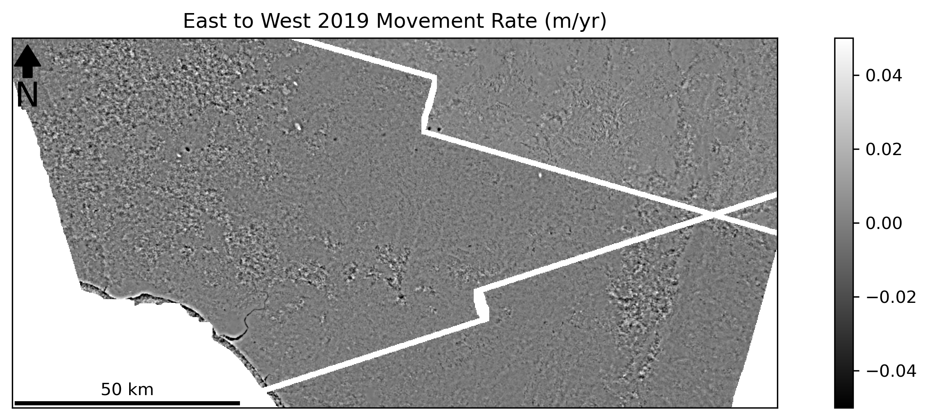
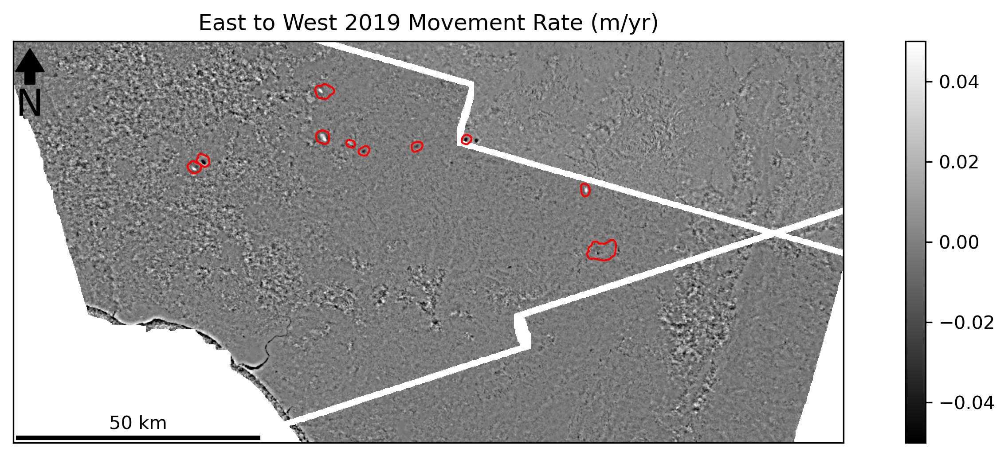
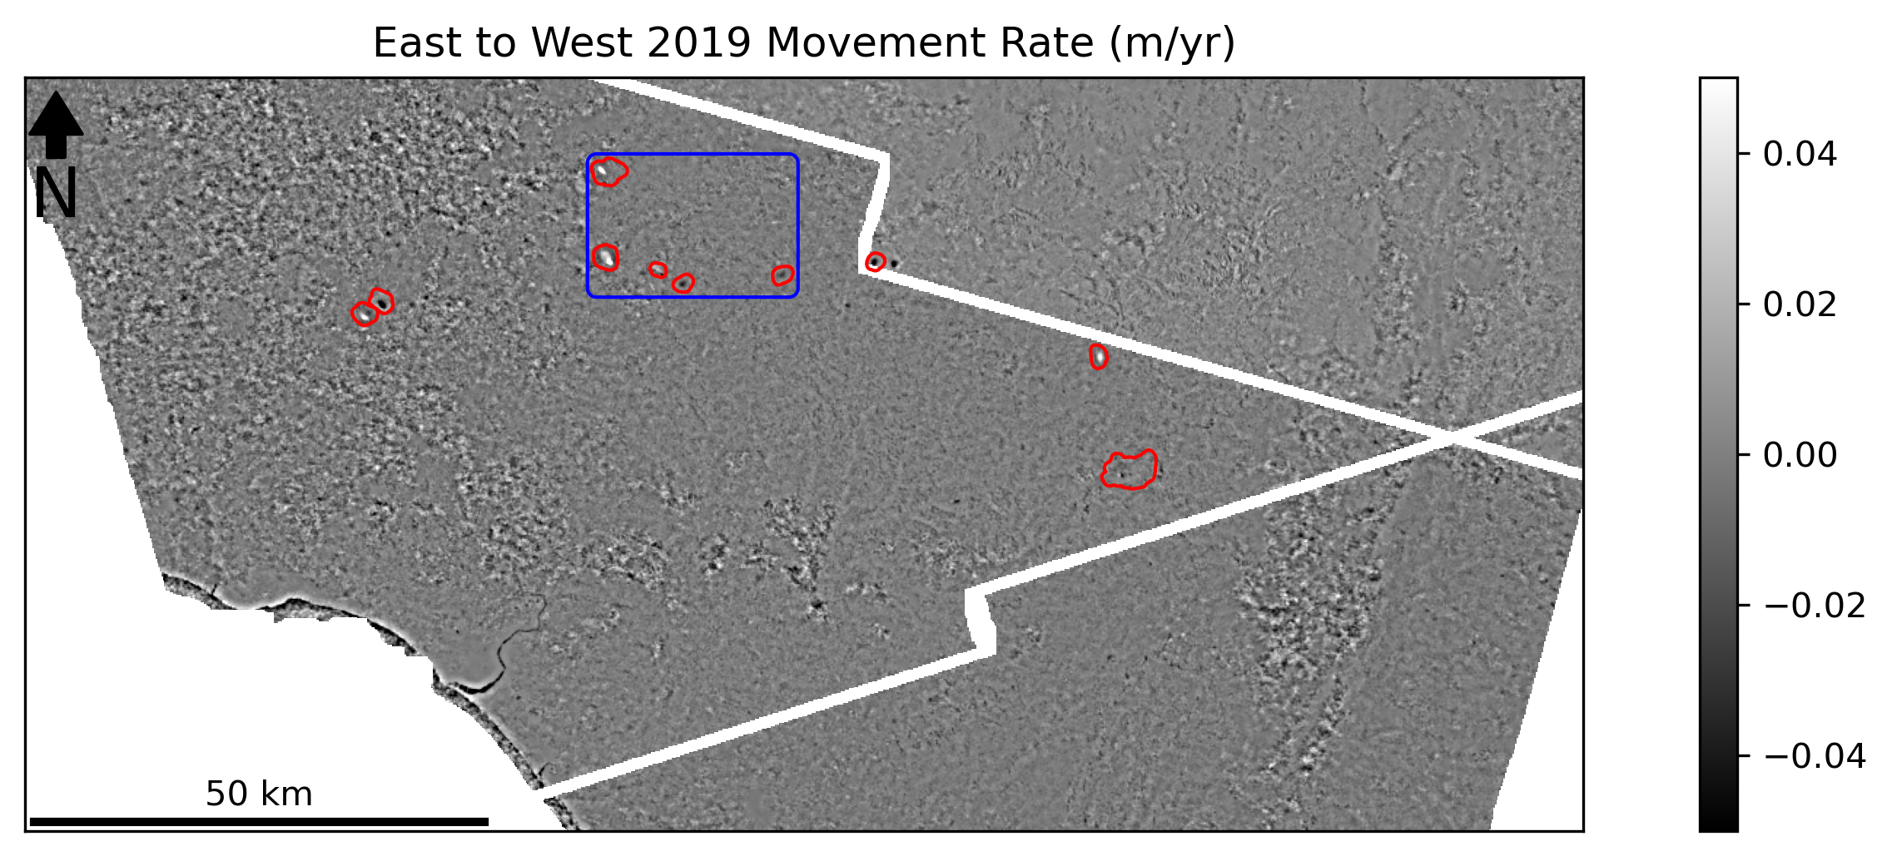
Motivation | Workflow | Results | Next Steps
Notes:
The first result I’d like to you show you today is the east to west movement rate for the study area in 2019. The grayscale image is the InSAR velocity in units of meters per year, where white represents movement to the east and black represents movement to the west.
In western portion of the study area, there is more noise due to the presence of forest cover, but in the majority of the study area which is composed of range and brush land, we see relatively clear results.
While local deformation signals can be hard to see at this scale, I’ve highlighted some mapped landslides with a strong deformation in red (ADVANCE). To get a closer look at a few of these, let’s take a look at the area in this blue box (ADVANCE).

Slide 6
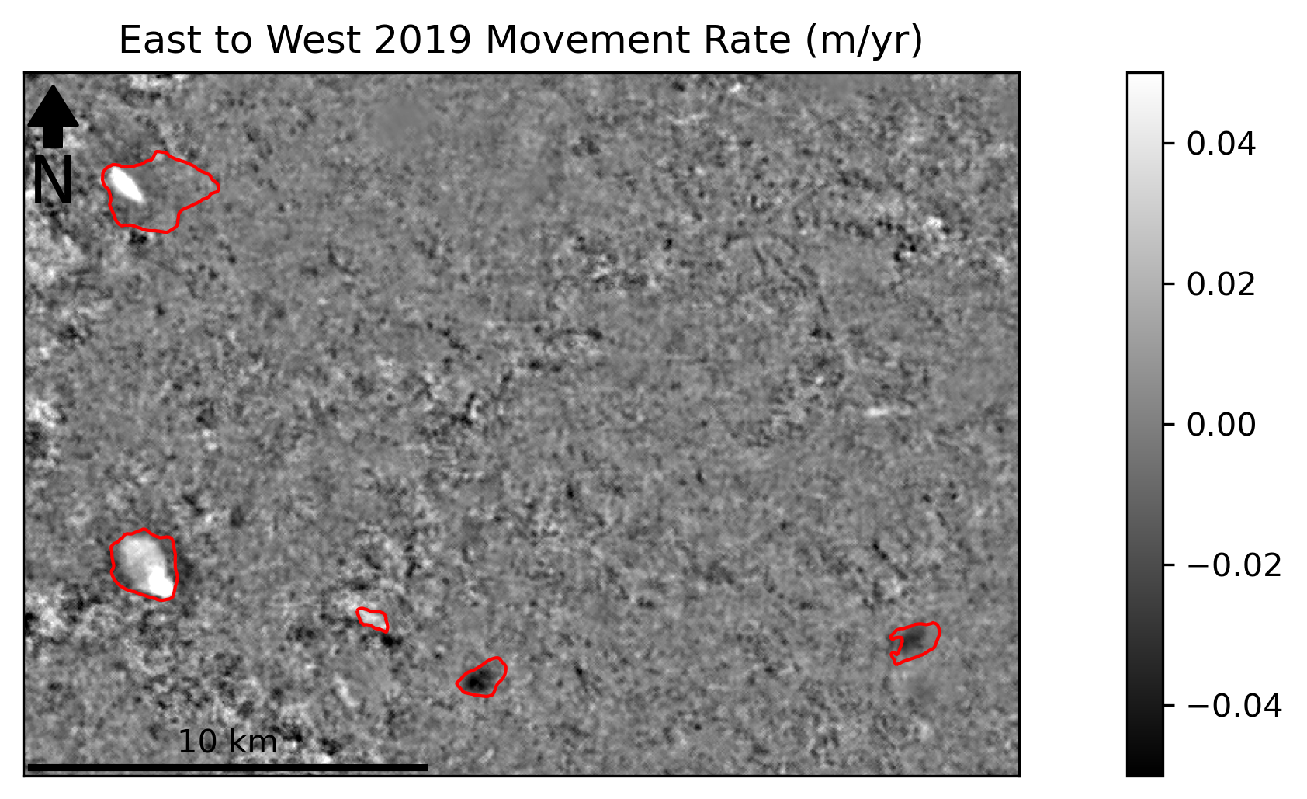
Motivation | Workflow | Results | Next Steps
f.williams1@massey.ac.nz
Notes:
While there is still noise present in the data, you can see that we are clearly picking up a strong signal of several landslides in this area. Some landslides (such as the landslide in the landslide in the southwest corner) show movement over the entire landslide, while others (such as the landslide in the northeast corner) show movement in only a portion of the landslide area.
Let’s look at two of these landslides in greater detail. The first one we’ll look at is the smaller landslide in the southeast corner.

Slide 7
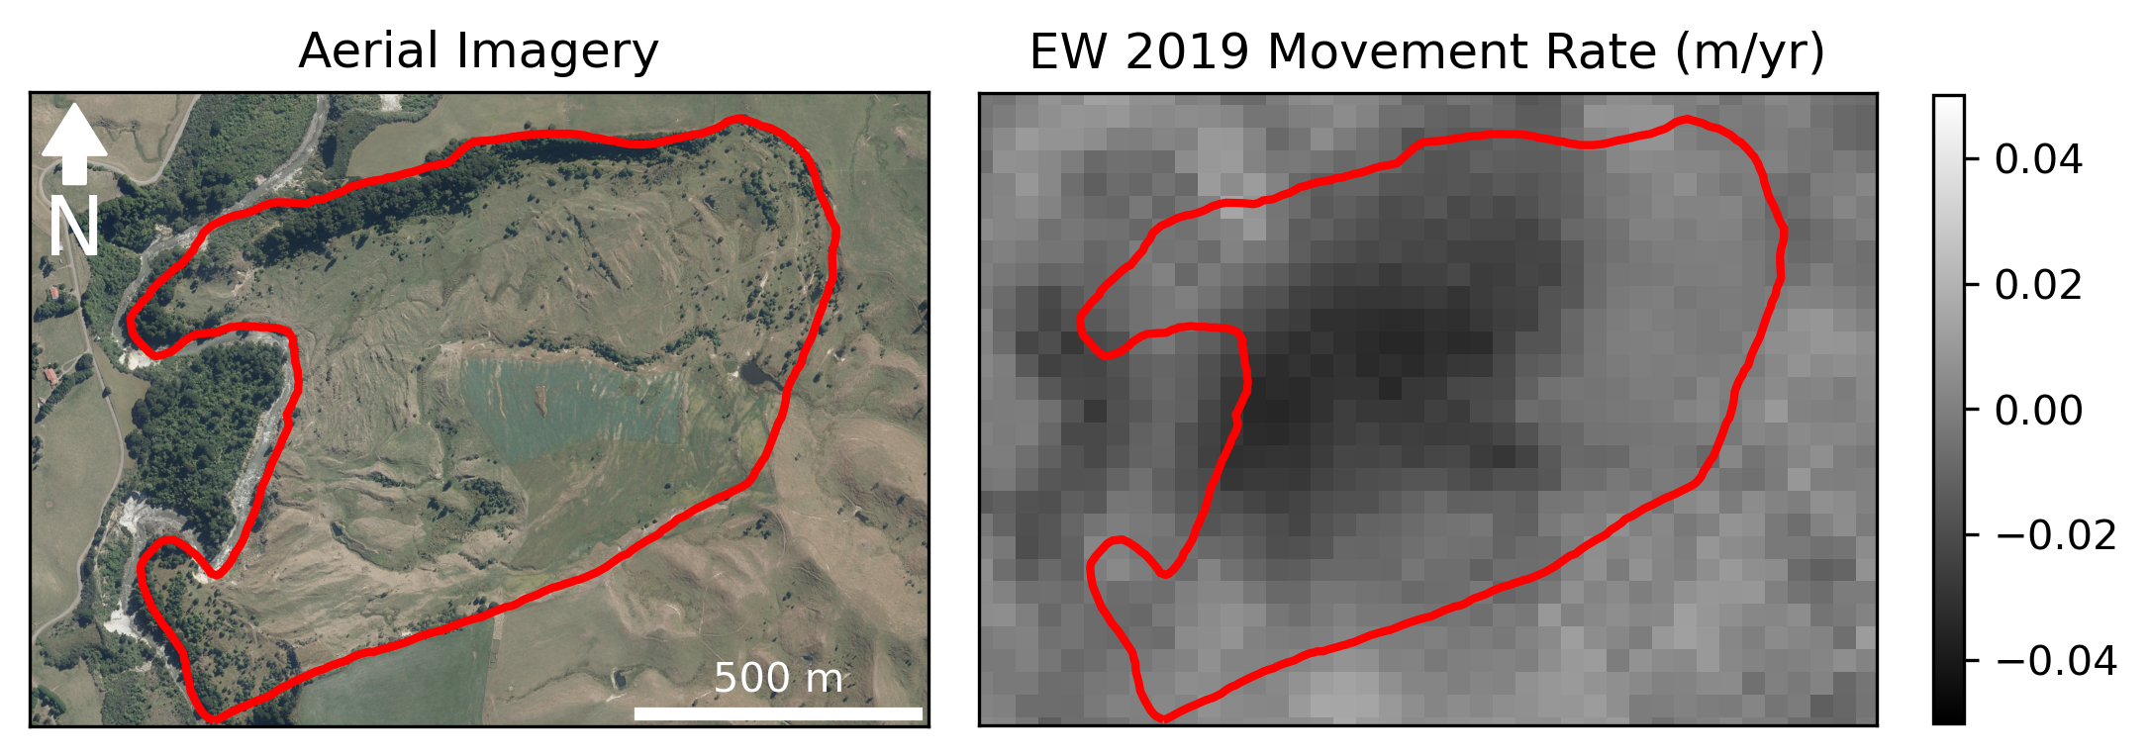
Motivation | Workflow | Results | Next Steps
f.williams1@massey.ac.nz
Notes:
Here on the right we have an aerial image of the landslide from 2016, and on the left we have the insar results of the same location, using the same scale as the previous map.
We can see here that the strongest motion signal in the insar data corresponds to an area of landslide that has a series of fresh scarps that also abuts a local river. The agreement between the geomorphogical evidence in the imagery and the InSAR data allows us to be confident that the insar analysis is accurately detecting movement at this landslide.

Slide 8
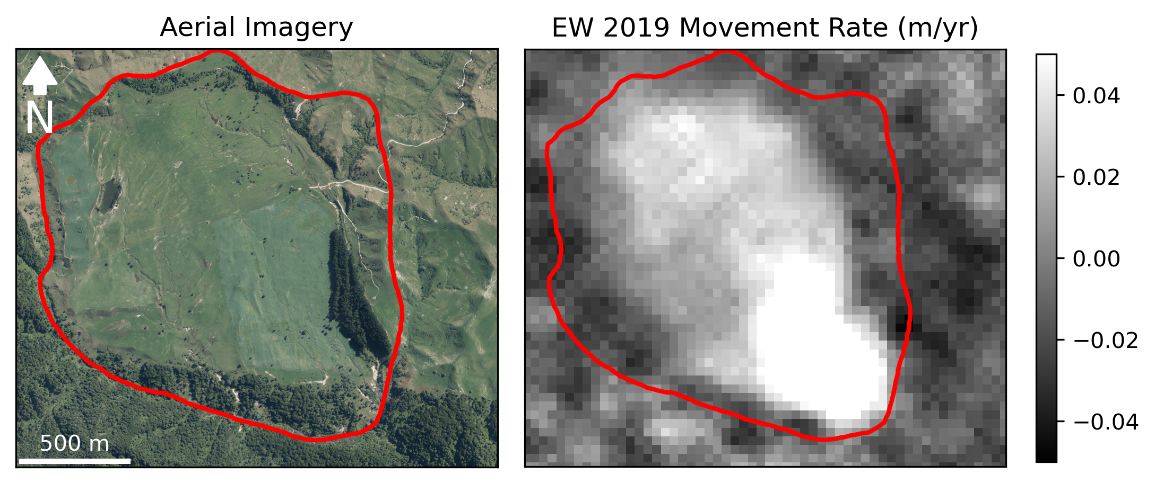
Motivation | Workflow | Results | Next Steps
f.williams1@massey.ac.nz
Notes:
Another interesting landslide to look at is the landslide in the southwest corner of map. This landslide is a fantastic example of our ability to detect differences in relative movement within a single landslide.
In this case the majority of landslide is moving at a relatively moderate pace, but the toe of the landslide appears to be moving at a much faster rate. Without insar, the difference in relative movement rates at this landslide would have been difficult to observe without conducting repeat in-field surveys that would costly and time-consuming

Slide 9
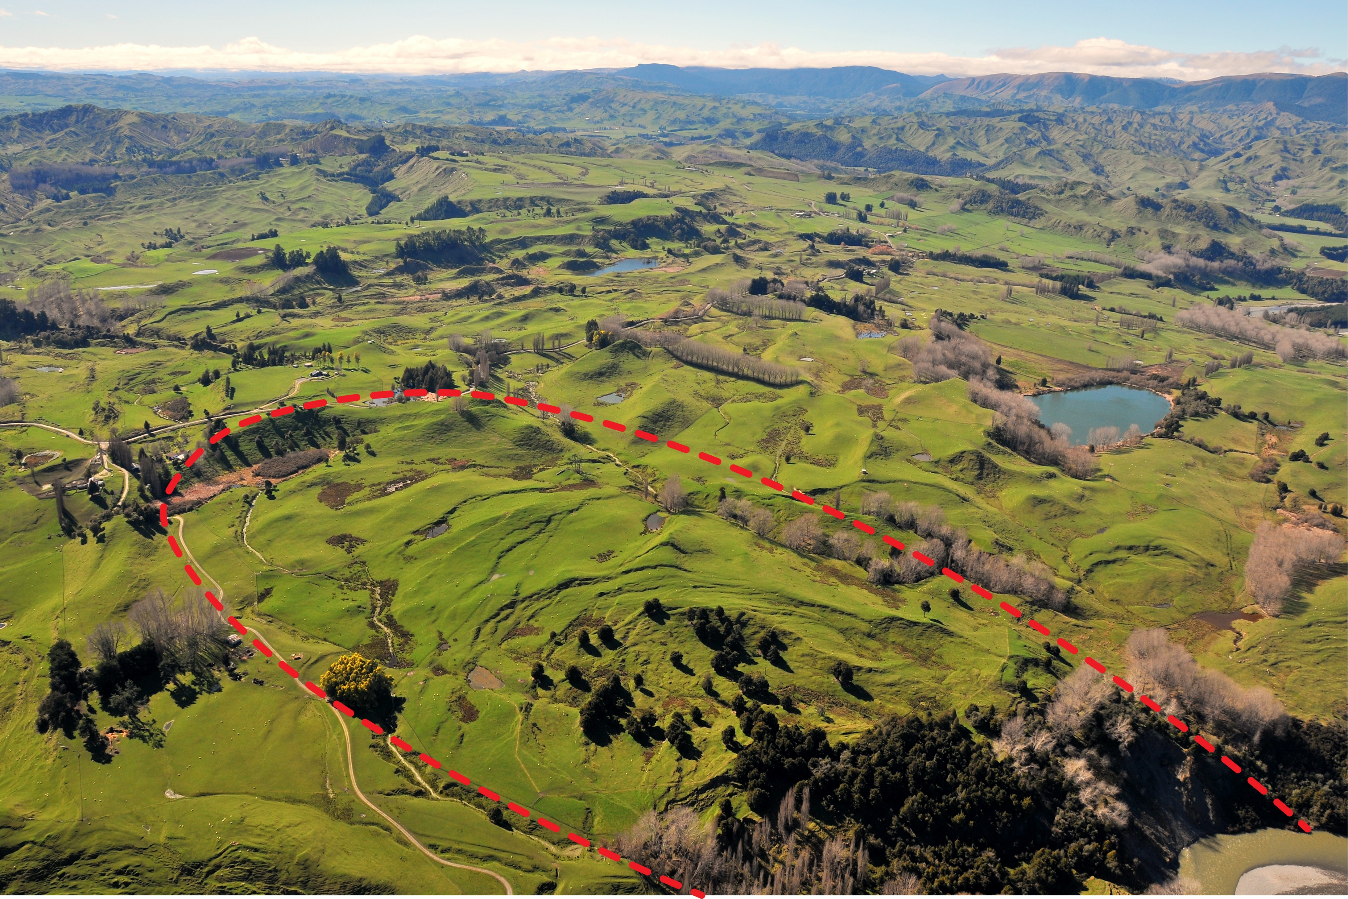
Motivation | Workflow | Results | Next Steps
f.williams1@massey.ac.nz
Notes:
I also want to highlight some of the early results from our pixel offset analysis. In this case, we’ll be looking at another landslide in the eastern portion of our study area, the Rangitikei landslide.
This image, which was taken from a helicopter shows an oblique view, of the Rangitikei landslide within the larger Poroa landslide complex. The boundary of the Rangitikei landslide is highlighted in red.
This landslide is the subject of another study that is under review for publication and as part of that study, 24 survey pegs placed within this landslide were surveyed from 2015 to 2019. This dataset serves as an excellent ground truth data source for our pixel offset measurements.

Slide 10
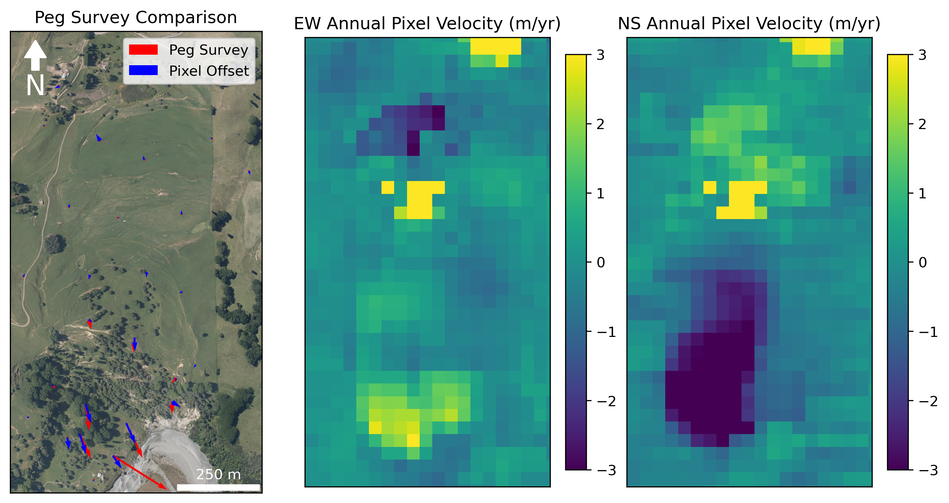
Motivation | Workflow | Results | Next Steps
f.williams1@massey.ac.nz
Notes:
This figure shows a comparison between the survey peg and the pixel offset data for the Rangitikei Landslide. The left panel shows an image of the landslide with the average annual movement vector of both peg data in red and the pixel offset data in blue at the peg location.
The size of vectors in this image have been increased to enhance readability, but the relative size of the vectors is still correct. The middle panel and the right panel show the estimated annual pixel offset velocities in the east-west and the north-south directions respectively.
Overall, we see that the landslide is moving at less than 1 m/yr in the upper half of the landslide, but the speed in the lower half of the landslide increases until you reach approximately 5 m/yr at the toe of landslide where it intersects the river.
When movement rates exceed 1 m/yr, we see that the direction of movement of the pixel offset data is quite accurate, but the pixel offset measurement do appear to underestimate the annual velocity at the river’s edge. This could be due to the fact that that our pixel offset tracking is conducted within 40x40 m spatial grid, which likely creates a smoother version of the velocity field than is recorded by the surveys.
When compared to the survey peg measurements, we find that the velocity measurements in the East to west direction have an RMSE of 0.61 m and North to south measurements have an RMSE of 1.05 m. Based on this analysis, we feel confident that our pixel offset tracking is providing relatively accurate estimates of landslide movement rates in this area.
E-W RMSE: 0.61
N-S RMSE: 1.05
Magnitude RMSE: 1.22

Slide 11
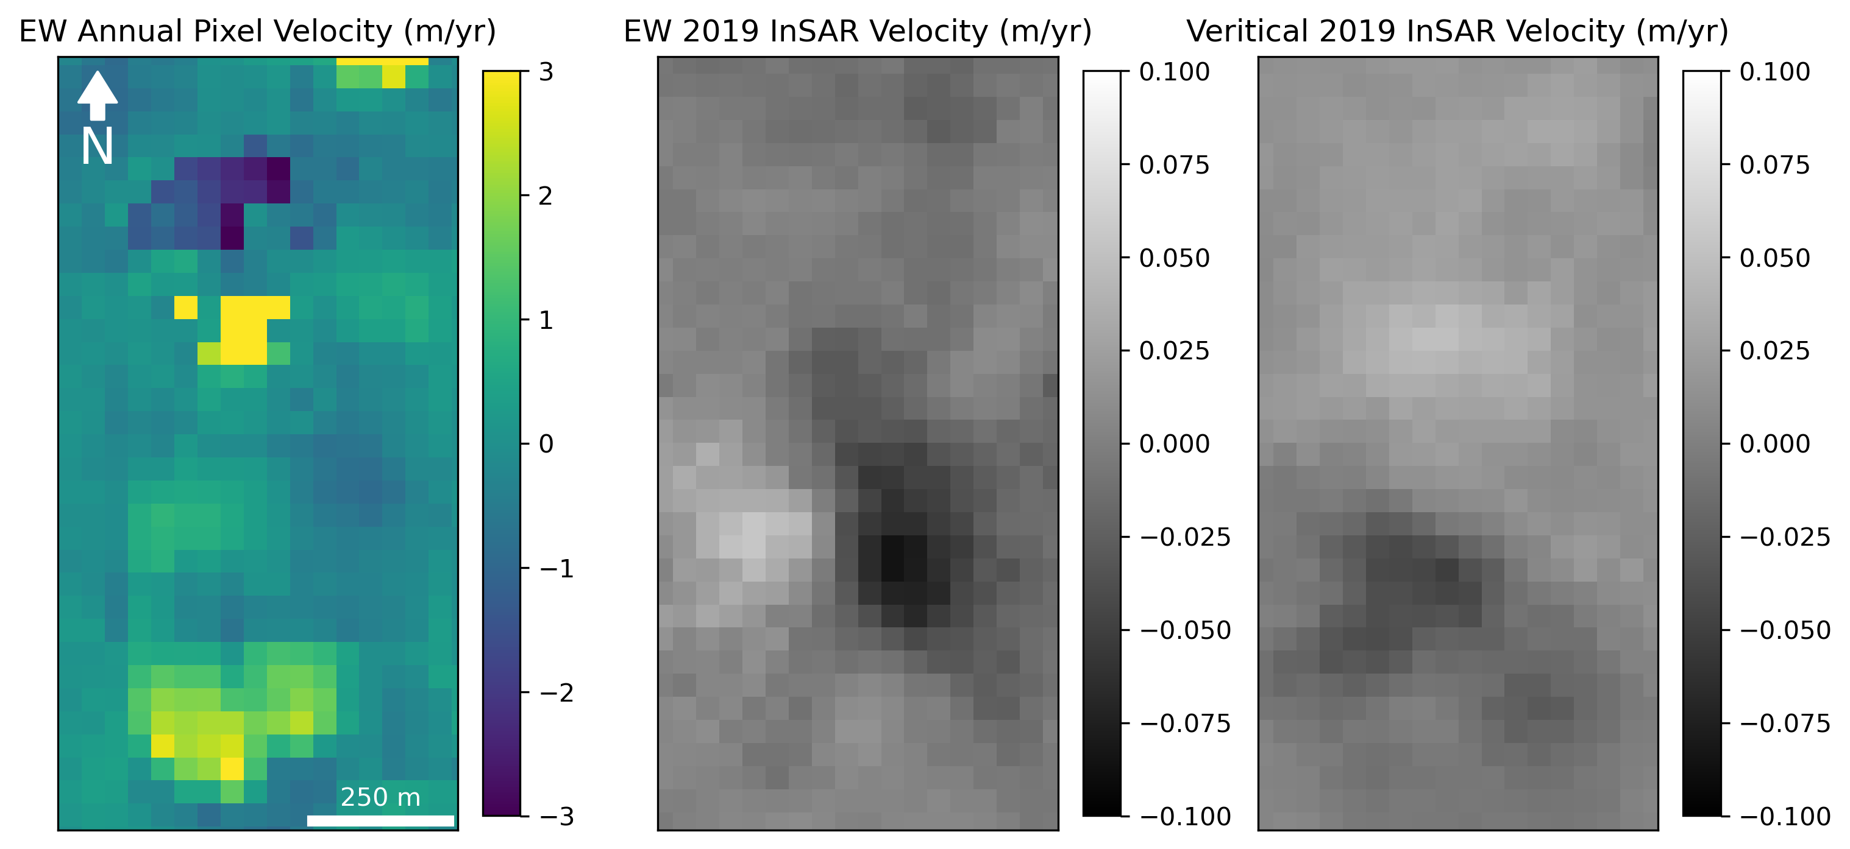
Motivation | Workflow | Results | Next Steps
f.williams1@massey.ac.nz
Notes:
While the InSAR also shows signs of activity at the Rangitikei landslide, the movement rates it reports are off by almost two orders of magnitude.
This figure displays a comparison between the pixel offset and InSAR data. In the left panel shows the annual east to west movement rate according to the pixel offset measurements, while the middle and right panels show the movement rate in 2019 according to InSAR in the east to west and the vertical directions respectively.
Based on this comparison, we think InSAR may drastically underestimate landslide movement velocities in landslides that are moving faster than a few centimeters per year. Or alternatively, only slow-moving areas along the edges of fast moving landslides show up as having fast movement rates in the InSAR data. However, if InSAR is combined with pixel offset tracking, it is possible to achieve a more accurate view of landslide activity.

Slide 12

Motivation | Workflow | Results | Next Steps
f.williams1@massey.ac.nz
Notes:
I’m really excited about progress we’ve made on this work and I’m also excited to announce that we have partnered with Descartes Labs to expand this analysis to a larger portion of New Zealand.
Descartes Labs is geospatial analysis company and is also leader a in cloud-computing based earth analytics. In the future we hope to leverage the power of cloud-computing to expand this analysis to areas across the globe!

Slide 13

Questions:
Email: f.williams1@massey.ac.nz
GitHub: forrestfwilliams
Twitter: @rs_forrest
Workflows:
InSAR: github.com/forrestfwilliams/hyp3_insar
Pixel Offset: github.com/forrestfwilliams/pixeloffset_mintpy
Data + Figures: github.com/forrestfwilliams/agu_2021
Thank you to Graham Hancox for the Rangitikei Landslide photography
f.williams1@massey.ac.nz
Notes:
Thanks once again for viewing my presentation! If you have any comments or questions about my work or anything else, please don’t hesitate to reach out! You can contact me through the conference app, at my email, or on twitter. All the notebooks used to create the results shown here can be found in the github repositories listed on this slide.

Slide 14
References:
Bekaert, David PS, et al. "InSAR-based detection method for mapping and monitoring slow-moving landslides in remote regions with steep and mountainous terrain: An application to Nepal." Remote Sensing of Environment 249 (2020): 111983.
Hogenson, Kirk, et al. "Hybrid Pluggable Processing Pipeline (HyP3): A cloud-based infrastructure for generic processing of SAR data." AGU Fall Meeting Abstracts. Vol. 2016. 2016.
Lei, Yang, Alex Gardner, and Piyush Agram. "Autonomous Repeat Image Feature Tracking (autoRIFT) and Its Application for Tracking Ice Displacement." Remote Sensing 13.4 (2021): 749.
Williams, Forrest, et al. "Intersection of fluvial incision and weak geologic structures cause divergence from a universal threshold slope model of landslide occurrence." Geomorphology 389 (2021): 107795.
Yunjun, Zhang, Heresh Fattahi, and Falk Amelung. "Small baseline InSAR time series analysis: Unwrapping error correction and noise reduction." Computers & Geosciences 133 (2019): 104331.
f.williams1@massey.ac.nz

Slide 15
Questions:
Email: f.williams1@massey.ac.nz
GitHub: forrestfwilliams
Twitter: @rs_forrest
Workflows:
InSAR: github.com/forrestfwilliams/hyp3_insar
Pixel Offset: github.com/forrestfwilliams/pixeloffset_mintpy
Data + Figures: github.com/forrestfwilliams/agu_2021
Thank you to Graham Hancox for the Rangitikei Landslide photography
f.williams1@massey.ac.nz
Notes:
Thanks once again for viewing my presentation! If you have any comments or questions about my work or anything else, please don’t hesitate to reach out! You can contact me through the conference app, at my email, or on twitter. All the notebooks used to create the results shown here can be found in the github repositories listed on this slide.

Slide 16
I’d Love to Talk About:
Automatically identifying landslides signals in InSAR data
Estimating sediment output of landslides using pixel-offset data
Motivation | Workflow | Next Steps
Notes:
Moving

